Slide 1


Developing a Tableau culture at your Organization
Snehith Allamraju

Slide 2

Snehith Allamraju Global Business Intelligence Manager @ Nobel Biocare, Envista Co
12 years of experience in the Business Intelligence and Analytics domain
Experience working with data warehousing, ERP, CRM visualization and analytics tools across SAP, Oracle, Microsoft stacks and Tableau
Tableau Desktop Specialist and Certified Associate
Certified SAP BI consultant and Azure Data Scientist

Slide 3

Prerequisites
Analytics Strategy
Data Engineering/ Data Ops
Content Governance
Notes:
Analytics Strategy
How can the team/user fully utilize tableau. Analytics needs . Is Tableau the right tool? What would the roadmap look like for the outcomes.
Data Engineering/ DataOps
Have your systems/data layers prepared and ready for consumption
Build an agile architecture for your data layers.
Your data must ideally be cleaned and prepared at a basic level for users to start their training.
Strong metadata and published data sources
Setup your server architecture for success
Have monitoring enabled on your tableau server, ensure there is proactive monitor performance
Define criteria to segment your users as creators or explorers or viewers. What is their role? How do they plan on working with the data?
Live vs extract
•Process for creating and sharing metadata
•Published and certified sources
•Data stewards in “the business”
Server onboarding
•Project structure
•Data source + Viz performance
Content Governance
Ease of Access is critical
Make it easy for the users to reach out to you. Whether it is through a common channel or a shared service like IT, make sure users can know or get to whom to reach out to.
Define role based mapping to categorize users
Use Authorization forms or a system to ensure users can request access to specific datasets. You would have already decided upon your project, group level access security.

Slide 4

Education

Slide 5
Education – What do we have out there?
Official Training Videos
Starter kits
Onboarding toolkit/Checklist
Tableau e-Learning Platform
Community
Blogs/ articles
Tableau Public
Notes:
Tableau provides official training videos at https://www.tableau.com › learn Tableau starter kits help see and understand your data with Tableau. https://www.tableau.com/solutions/gallery/starter-kits
Tableau also suggests an onboarding and enablement checklist to assess your workforce's training and enablement needs and build a plan to bridge any gaps as the next stephttps://www.tableau.com/learn/whitepapers/SGCustChamp-Onboarding-Enablement-Checklist
Tableau eLearning is web-based training you can consume at your own pace. Courses are interactive and designed to help you learn how to use Tableau, regardless of your skill level. Hands-on activities and knowledge checks ensure you retain what you learn. Helps in guided learning for the users as it Role based (Creator vs Explorer).
Tableau has a wonderful community of practitioners, teachers and learners who are willing to teach, contribute and spread their knowledge. Blogs and articles, as well Tableau public are good inspirations for users who are new to Tableau.
Remember, it might also overwhelm them so you need to balance it out.
Tableau knowledge base and whitepapers

Slide 6

Education – What We do
Official Training Videos
Onboarding toolkit/Checklist
Tableau Tuesday Training hours – Webinars
On request 1:1 & Department trainings and Group workshops
Notes:
As a part of our onboarding checklist, We start off with pointing the users to Tableau provided official training videos. We then go through our internal onboarding toolkit / checklist .
We organize Tableau Tuesday training hours, webinars where any one can hop on and listen to the topic of the day. Topics range from basics to advanced, as well as specific topics users might have requested for.
We also organizing 1:1 trainings to new/existing users, Department trainings and group classroom wors

Slide 7

Education – What Tableau can help with
Tableau Days
Lunch and Learn
Dedicated Tableau Tech Talks
Contact your account managers!
Notes:
Tableau day are usually full day events that Tableau can help organize, Company-wide Event to Share Stories where they present New Features/Functionality, Key notes, use cases, product updates, hands-on working sessions, technical discussions and internal training as well as Q&A.
Internal teams sharing their work in Tableau
Lunch & Learn : Lunch-and-learn events are an informal option to help users learn from each other. Schedule a monthly, lunchtime meeting where people can bring their food in and listen, or if possible, even arrange for food to be brought in. This will definitely increase your attendance rate.
Dedicated Tableau Tech talks: Helping people gain insight into their data to solve unexpected problems is what drives Tableau. They can help organize webinar series on multiple topics for your own organization as well! Topics can range from Visual analysis, Introduction, Excel with Tableau, Calculations, Dashboard, Table calcs, Joins etc

Slide 8
Recommendations / Learnings
Some people chose not to use standard content as they are not comfortable with them. That’s ok.
Data Literacy is subjective. Tailor your education content/ trainings to your audience
Develop through coaching. Build Proof of concepts.
Progression of skills over time always works.
Notes:
Analysts vs Executives
Creators vs viewers
Expertise and Learning curve
Start from the data your audience works with. Demo data can only take you so far. To help users understand the skills needed for their job function and license type, publish learning plans for each of the roles: Site Admins, Project Leaders, Creators, Explorers, and Viewers.
Basics
Desktop II and III
Promoting and reinforcing best practices helps in knowledge management

Slide 9

Engagement
Notes:
Nurturing a community within your organization puts the power back in hands of the users who are closer to the data, than being with an IT or a BI team. You might have heard of or been implementing CI/CD, the two DevOps methodologies. But here we look at the third paradigm, which is even more critical, CE : Continuous Engagement

Slide 10

Types of User Engagement
Direct
Creation
Indirect
Subscriptions
Publishing content
Web authoring
Alerts
Notes:
Direct engagement includes viewing and interacting with a dashboard, connecting to a data source, and web authoring.
Indirect engagement includes subscriptions and alerts that are delivered to a user.
Different metrics can be used to measure these channels
Number of users logging in
Last logged in date
Most viewed workbooks

Slide 11

Measuring Engagement - Why
Helps understand User behaviors
Insights can be used to plan scale
Helps measure
Performance
Scalability
Sizing
Indirectly impacts licensing requirements and hardware
Notes:
Measurement helps your deployment to operate at scale and evolve. It helps you
understand user behaviors—who is creating and consuming content and the quality,
the relevance of the dashboards and data sources being published, and the use of certified versus sandbox. If content isn’t being consumed, you will be able to identify it and take the appropriate next steps.
Understanding the relationship between data sources and workbook content, users, and server performance, scalability, and sizing is a reliable way to look into current usage and future growth.
Open communication between Server Administrators and Site Administrators is needed to plan for new users and use cases on the platform.

Slide 12

Measuring Engagement - How
Where
Traffic
Who
Users
What
Content
Tableau Administrative views
Custom views
Notes:
The three metrics that matter for measuring user engagement are Traffic, Users and Content.
Administrative views are dashboards that are included with Tableau Server and help you understand how users are interacting with content. Traffic to views, datasources etc can help understand the most popular content or page.

Slide 13

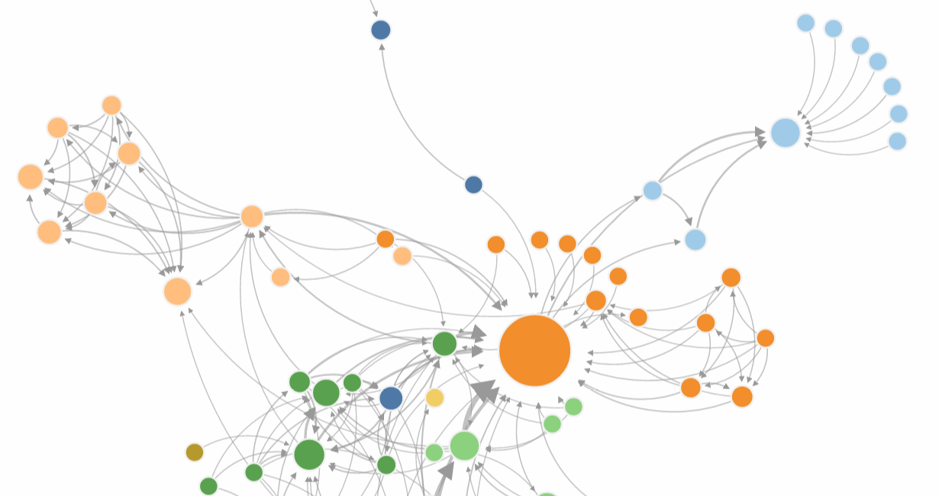
Means for engagement
User group distribution list
Analyst conferences
Champion development
Gamification
Tableau days
Collaboration platform : An internal Tableau intranet site
Viz games
Notes:
Build a Community network diagram for your community of practice
”Places” for people to come together
•An internal Tableau intranet site
•A Tableau channel in Slack or other group chat platform
•Monthly newsletters with tips and tricks, events, resources, and sharing of use cases
Collaboration Platform:
Social Capital : Building informal connections to strengthen members’ community by sharing expertise and learning from others
Community of Practice:
Establish regular communication and meeting cadence
In person face to face meetings to strengthen relationships
Viz Games:
Makeover Monthlies
•Run an Iron Viz
•Viz Hack-a-thons
•Loads of variations
Run Viz competitions
Champions:
Let them set an example and help drive engagement
•Speak at TUG meetings
•Proctor Skill belts
•Run Tableau Doctor Days
•Help run Viz competitions and present at Tableau Days
•Represent externally
Find and Promote

Slide 14
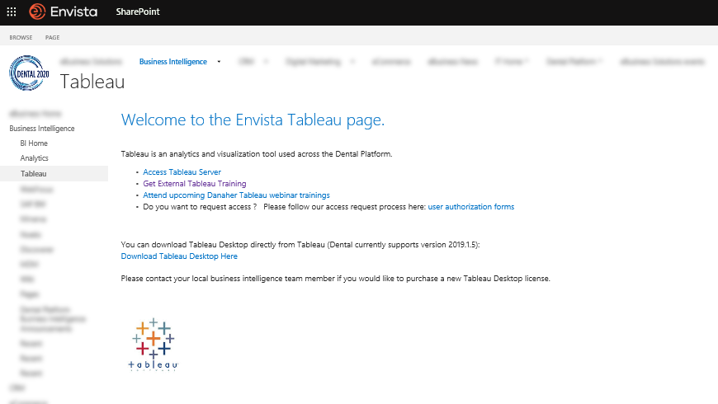
Share point Page

Slide 15
Recommendations / Learnings
Identify facilitators
Build prototypes
Sort out your licensing
Offer and assign roles in TUG
Engage users for feedback
Data + Women!
Guest speakers from Tableau + local community
Notes:
Being part of a community helps foster higher quality work and engages everyone.
Licensing
========
Users can get confused with the types of licenses to buy.
Having a quote tracker helps to track requests

Slide 16
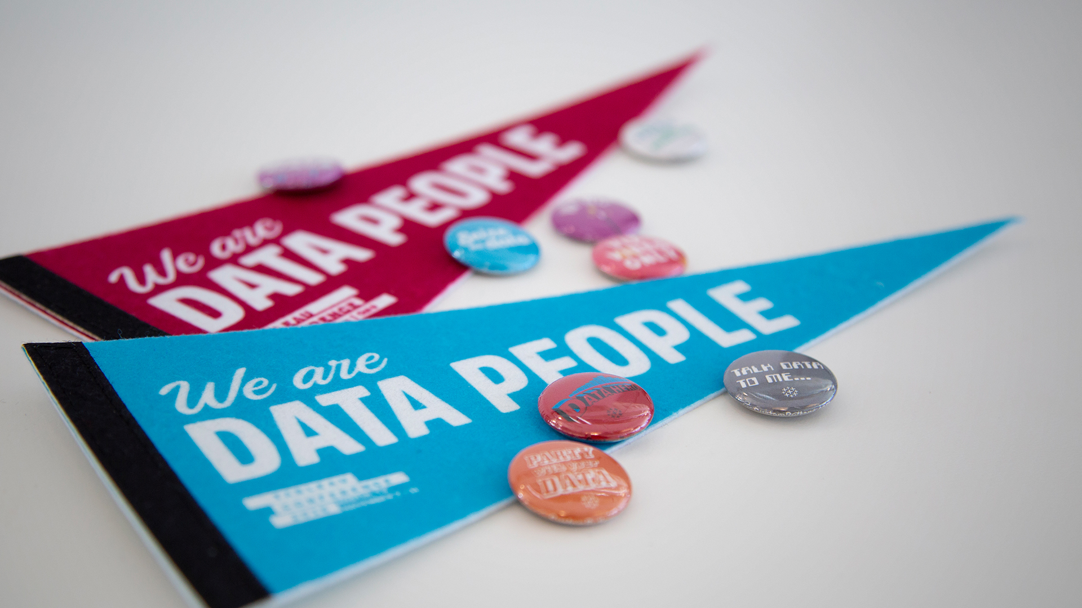
Next steps for us
Implement a skill belts program
Customized training for certifications
Org wide Iron viz
Org Level official TUG
Notes:
Recommend : Skill Belts in a Box | Our Journey from TC’18
gamifies your team's learning, encouraging individual members to make progress toward data visualization mastery!

Slide 17
Enterprise Executive Strategy + Data strategy + Tableau + Education & Engagement = Success!
Take away slide for you!
Training
Resources
Guidance
Collaboration
Community
Platform/Portal
Continuous Engagement

Slide 18

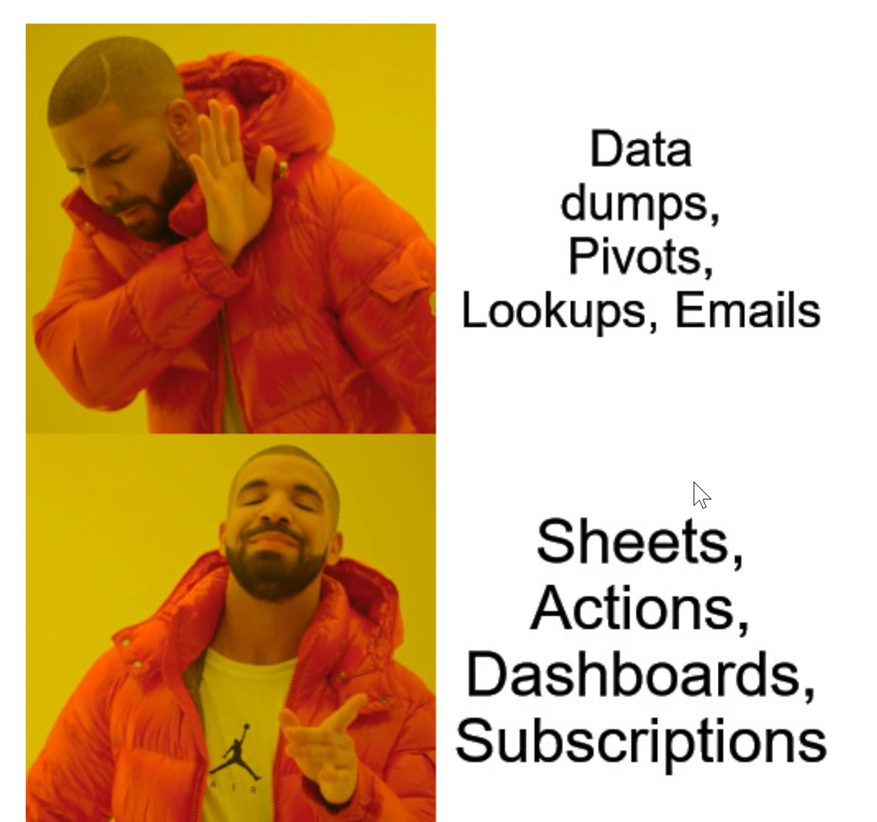
Help your users grow
From here
To here

Slide 19
Useful resources
https://help.tableau.com/current/blueprint/en-us/bp_education.htm
https://help.tableau.com/current/blueprint/en-us/bp_internal_tableau_activities.htm
https://www.tableau.com/learn/webinars/measuring-engagement-three-metrics-matter
https://help.tableau.com/current/blueprint/en-us/bp_measure_user_engagement.htm
https://help.tableau.com/current/blueprint/en-us/bp_champion_development.htm
https://community.tableau.com/thread/201775

